Slide 1
Portfolio
Pulse
Team 2

Slide 2
Table of contents
01.
03.
02.
04.
Introduction
Technology Stack
Key Features
Demo Preview

Slide 3

Introduction

Slide 4
Why PortfolioPulse?
Problem statement
Investors struggle to track multiple portfolios manually.
Lack of real-time insights and performance visualization.
Time-consuming transaction reconciliation.
Our idea
One-stop platform for portfolio tracking and management.
Automated reconciliation and transaction handling.
Data-driven visuals for performance analysis.

Slide 5
Key Features
- ️ **Dashboard Overview**: Get a complete view of your financial portfolio in one place.
- **Portfolio Management**: Add, update, and manage multiple portfolios with ease.
- **Transaction Handling**: Record transactions and keep track of your investment movements.
- **Transaction Reconciliation**: Automatically reconcile transactions and adjust your portfolio accordingly.
- **Visual Insights**: Data visualizations (charts and graphs) to analyze portfolio performance.
- **Responsive Design**: Fully optimized for mobile and desktop viewing.
- ️ **Dynamic Routing**: Seamlessly navigate through different components and views.

Slide 6
Technology Stack
React.js ⚛️
Formik & Yup for form handling and validation
TailwindCSS for responsive styling
React Router for dynamic routing
React Suspense & Lazy Loading for performance optimization ⚡
Chart.js for visualizing portfolio performance
Local Storage for data persistence ️

Slide 7
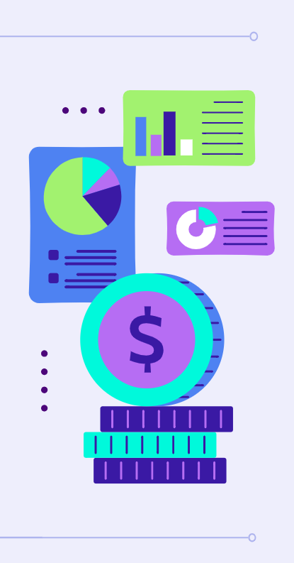
Demo Preview
Visuals
Features
Showcase the design of your product
What makes your product unique?
Price
Availability
Share the cost and price with investors
When is the product expected to be ready?

Slide 8
Thanks!
Do you have any questions?

